Slide 1
Knowledge Submission
Name: Rekha Ramtirthkar
Internship Type: Project Based Internship
Date of submission: 08/02/20204

Slide 2
Task
zoho one tool: How to delete inactive user accounts.

Slide 3
Zoho one overview
About Zoho One
Zoho One is an integrated business management suite designed to help organizations of all sizes manage sales, marketing, finance, human resource (HR) and more. Features include quoting, digital signatures, project tracking, accounting, kanban board, contact management and group calendars.
The application enables sales teams to generate leads, manage client records and communicate with them via phone, live chat or online meetings. Marketers can build custom websites and utilize visual analytics to track visitor's engagement and interaction with pages. It also assists HR managers with applicant tracking, resume parsing, interview scheduling, time tracking and onboarding. Zoho One enables support teams to manage tickets, provide remote assistance through screen sharing and track ticket resolutions. Businesses can handle multi-channel orders and monitor stock levels across warehouses. It comes with mobile applications for iOS and Android. The solution is available on monthly and annual subscriptions and support is provided via email, documentation and forums.

Slide 4
Features of Zoho One
Improve business processes
An integrated and customizable system
Fully customizable Sales process and Workflow automation
Real-time performance dashboards and Automated report generation
Communication tools and Real-time notifications
Marketing, Email Campaign Management

Slide 5
Social media interaction management
Invoices and estimate creations,
Inventory handling
Tracking income and expenses
Powerful analytics
Website tracking functionality
Third-party integrations

Slide 6
Benefits of zoho one
Integration of Sales Reports and Figures
Zoho One allows the easier facilitation of sales data across all channels and gives up-to-date sales reports which can be used for better decision-making.
All-in-one Marketing Solutions
With Zoho One, marketers can keep track of all the numbers for reach and engagements. It is also used to build a website for maximized content and reach.
Timely Customer Support
Zoho One consolidates all the ways in which a customer can approach the business and this might be through e-mail, live chat, phone, social media posts, self-service, or remote assistance.

Slide 7
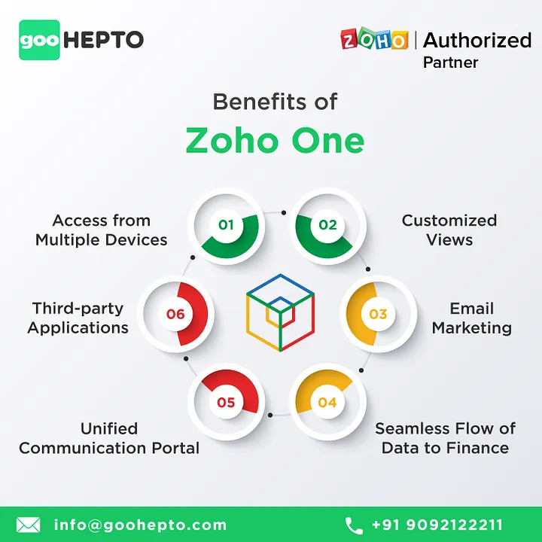

Slide 8
Management of Orders
Zoho One is equipped with a set of tools that can be used to quickly fulfill orders and easily manage the inventory through multiple channels. So with Zoho One businesses will be able to get real-time updates on their resources and can better allocate for distribution.
Accounting Made Easy
Zoho One allows the sending of invoices and payments on time, fully avoiding the possibility of any delayed payments and transactions. It makes it a lot easier to categorize every transaction and cash flow and also gives a visual representation of the business’s financial health.
As a Zoho implementation partner, GooHepto provides a top-notch business management system to our clients with a wide range of above-creative Zoho Development Services. Are you looking for a Zoho Partner for your business? We have Zoho Masters and experienced professionals who have worked across various industries and enabled businesses to leverage the features of Zoho CRM up to its full potential. We help you to optimize your business processes with our top-notch Zoho solutions, feel free to get in touch. We offer impeccable support to our clients.

Slide 9
Steps to delete inactive users accounts
1. Open the Zoho One app on your device.
2. Click in the top right corner, then click Users.
3. Select inactive Users.
4. on the right side of selected user delete symbol is there.
5. Click on Delete symbol.

Slide 10
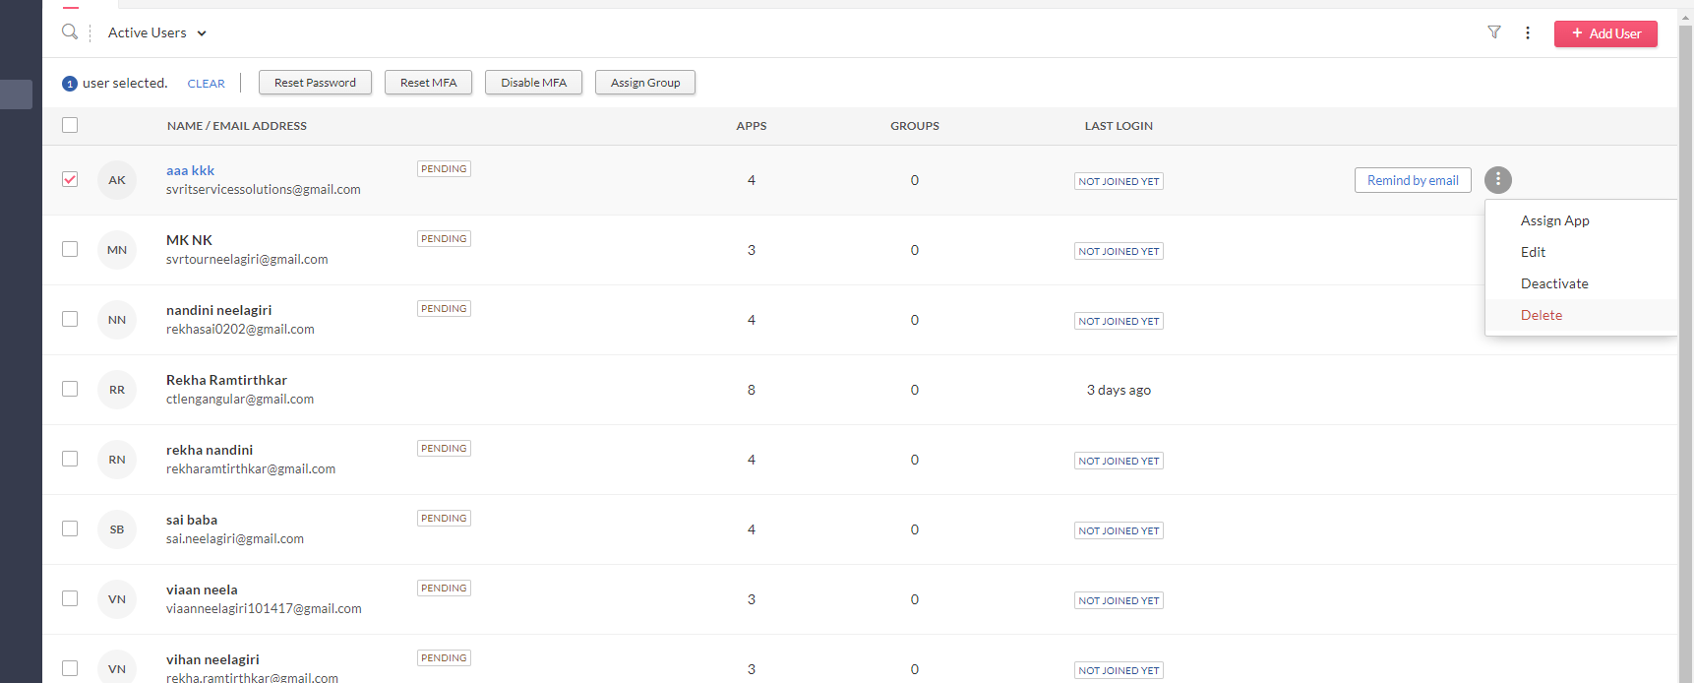

Slide 11
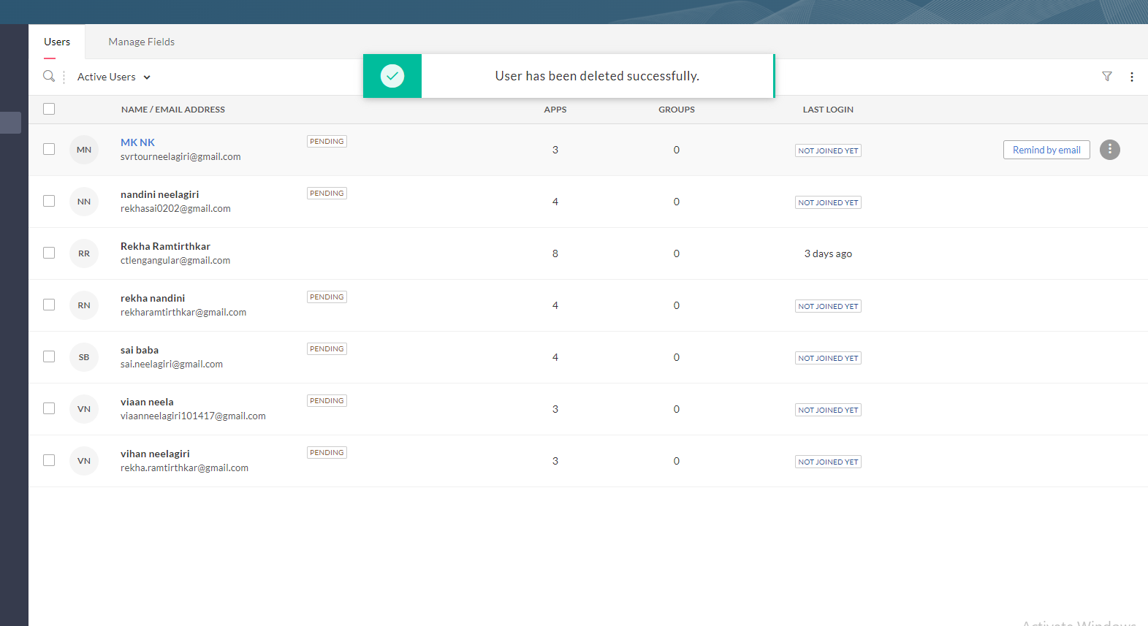
Same user get deleted

Slide 12
In conclusion
Zoho One can be a strategic move that benefits both Zoho and its customers. It allows for greater customization, market expansion, increased revenue opportunities, and enhanced competitiveness while catering to diverse industry needs.

Slide 13
Thank you

